Slide 1
by Hayes Roberts

Slide 2
One day the pirate Monkey was out running errands with his mom.

Slide 3
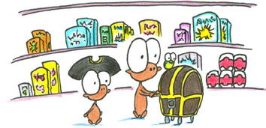
They shopped for groceries and ate peas at his favorite restaurant.

Slide 4
Then the pirate Monkey's mom said, "Oh yes, we need to stop off at the doctor's office for a quick checkup."

Slide 5
The doctor checked Monkey's heart, his blood pressure, and his knees.

Slide 6
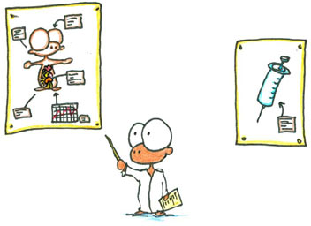
Then he explained that Monkey would come back the next day and get a shot, to protect him from scurvy or something.

Slide 7
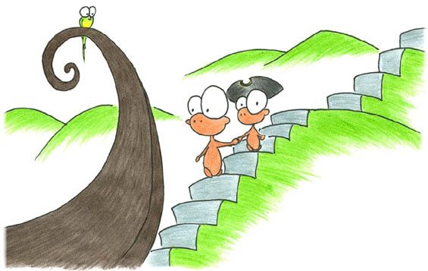
The pirate Monkey did not like shots.

Slide 8
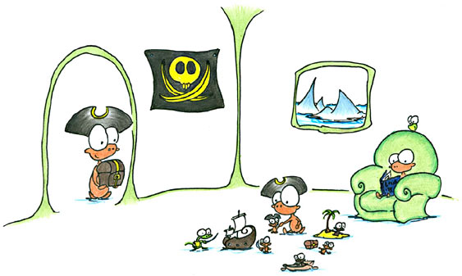
That evening his father came home and Monkey told him all about the visit to the doctor.

Slide 9
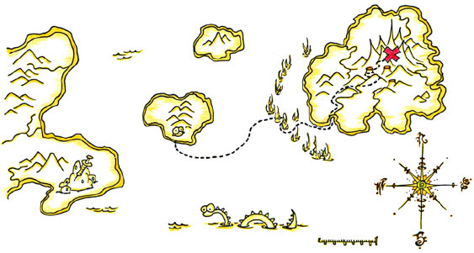
Monkey's father said, "Monkey, I know of something that can help you. Take this map and my fastest pirate ship and find it. Also, if you stay very still for the doctor you can have some ice cream."

Slide 10
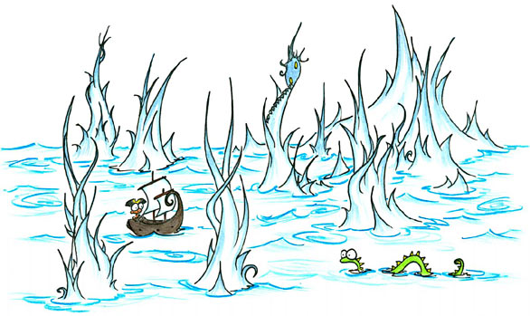
So Monkey followed the map through the wildest seas,

Slide 11
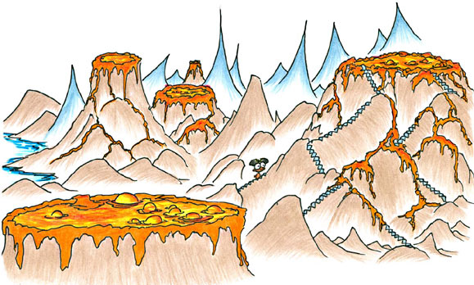
and climbed up volcanoes filled with fiery lava,

Slide 12
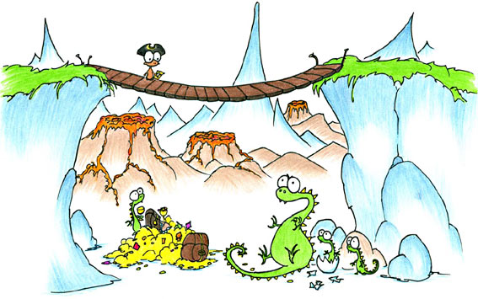
and sneaked past creatures so terrible that they will not be described in this book,

Slide 13
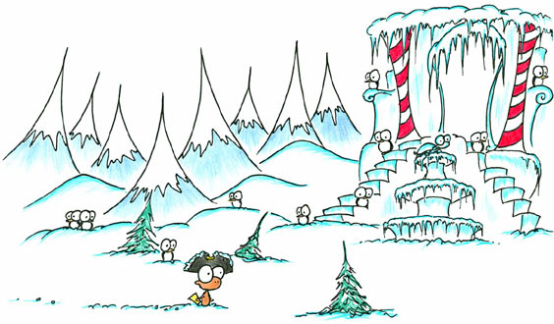
until he reached an icy castle at the top of the mountains.

Slide 14
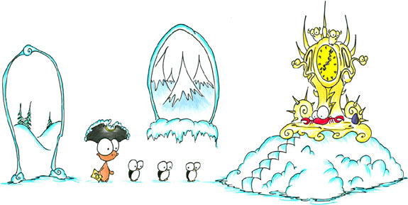
Inside, he found a great crab wizard on a crab wizard throne.

Slide 15
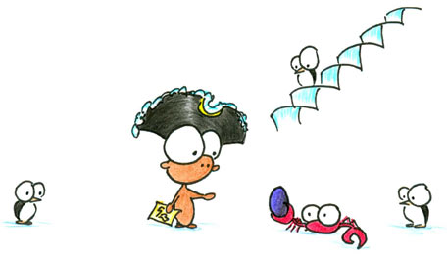
The crab wizard spoke these words, "Monkey Pirate, because you have braved many obstacles to get here I will give you this rock. When you get a shot, you must squeeze the rock very tightly, and count to three. You will be magically taken into the future where the shot will be finished. Also, you can have some ice cream after."

Slide 16
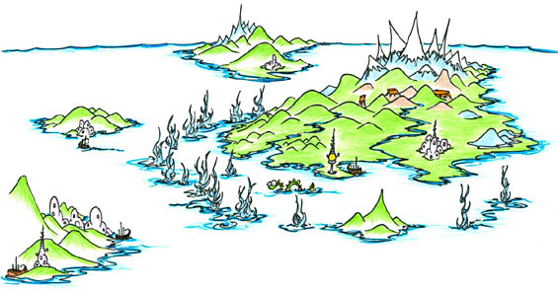
The pirate Monkey thanked him and sailed back home to get some sleep.

Slide 17
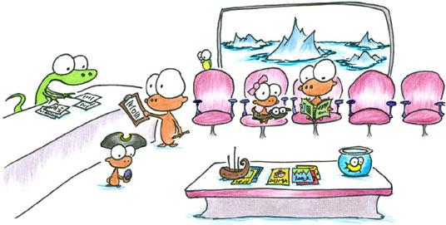
The next morning, he took the rock with him to the doctor's office.

Slide 18
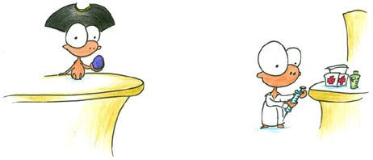
The doctor hummed a little song and filled up Monkey's shot.

Slide 19
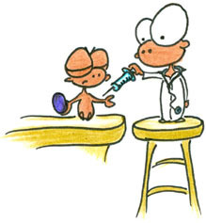
Modi closed his eyes very tightly, squeezed the rock as hard as he could, and counted 1, 2,

Slide 20
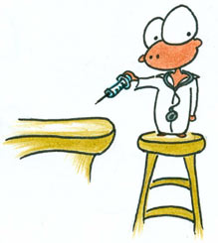

Slide 21
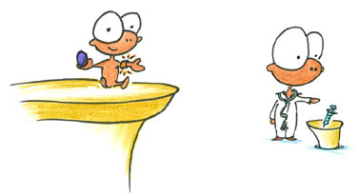
3! The crab wizard was right! The shot was finished. The Brave Monkey Pirate was now immune to scurvy and some other stuff.

Slide 22
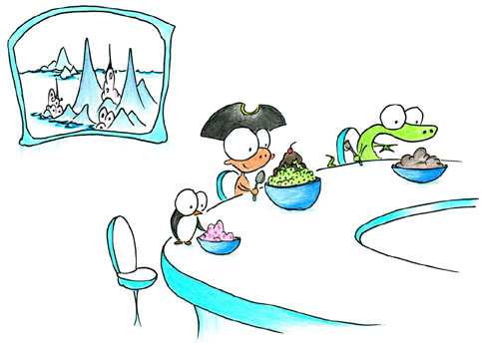
And he had ice cream on the way home.

Slide 23
The end

Slide 24
Set by skala hemed emim february 2013

